Slide 1
Clustering

Slide 2
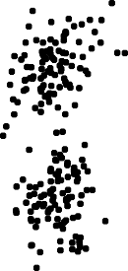
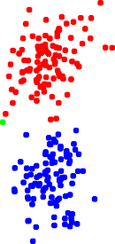
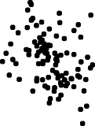
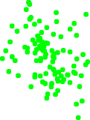
Clustering
^{e} given N n-vectors x₁, . . . , x_{N}
^{e} goal: partition (divide, cluster) into k groups
^{e} want vectors in the same group to be close to one another

Slide 3
Example settings
^{e} topic discovery and document classification
– x_{i} is word count histogram for document i
^{e} patient clustering
– x_{i} are patient attributes, test results, symptoms
^{e} customer market segmentation
– x_{i} is purchase history and other attributes of customer i
^{e} color compression of images
– x_{i} are RGB pixel values
^{e} financial sectors
– x_{i} are n-vectors of financial attributes of company i

Slide 4
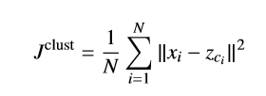
Clustering objective
^{e} G_{j} ⊂ {1, . . . , N} is group j, for j = 1, . . . , k
^{e} c_{i} is group that x_{i} is in: i ∈ G_{ci}
^{e} group representatives: n-vectors z₁, . . . , z_{k}
^{e} clustering objective is
mean square distance from vectors to associated representative
^{e} J^{clust} small means good clustering
^{e} goal: choose clustering c_{i} and representatives z_{j} to minimize J^{clust}

Slide 5


Partitioning the vectors given the representatives
^{e} suppose representatives z₁, . . . , z_{k} are given
^{e} how do we assign the vectors to groups, i.e., choose c₁, . . . , c_{N} ?
^{e} c_{i} only appears in term in J^{clust}
^{e} to minimize over c_{i}, choose c_{i} so
^{e} i.e., assign each vector to its nearest representative

Slide 6


Choosing representatives given the partition
^{e} given the partition G₁, . . . , G_{k} , how do we choose representatives
z₁, . . . , z_{k} to minimize J^{clust}?
^{e} J^{clust} splits into a sum of k sums, one for each z_{j}:
.
^{e} so we choose z_{j} to minimize mean square distance to the points in its partition
^{e} this is the mean (or average or centroid) of the points in the partition:
.

Slide 7
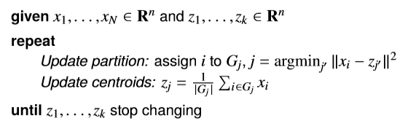
k-means algorithm
^{e} alternate between updating the partition, then the representatives
^{e} a famous algorithm called k-means
^{e} objective J^{clust} decreases in each step

Slide 8
Convergence of k-means algorithm
^{e} J^{clust} goes down in each step, until the z_{j}’s stop changing
^{e} but (in general) the k-means algorithm does not find the partition that minimizes J^{clust}
^{e} k-means is a heuristic: it is not guaranteed to find the smallest possible value of J^{clust}
^{e} the final partition (and its value of J^{clust}) can depend on the initial representatives
^{e} common approach:
–run k-means 10 times, with different (often random) initial representatives
_{J}clust
–take as final partition the one with the smallest value of

Slide 9
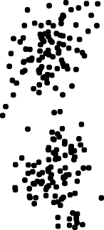
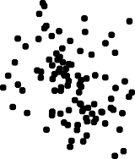
Data

Slide 10
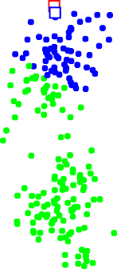
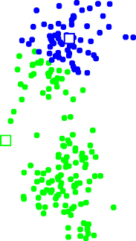
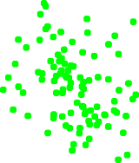
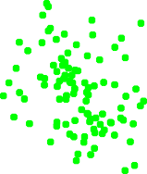
Iteration 1

Slide 11
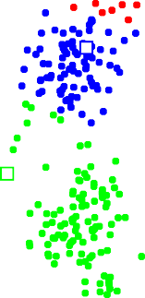
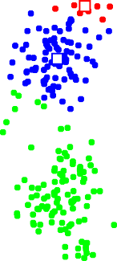
Iteration 2

Slide 12
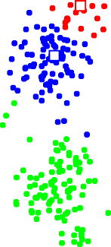
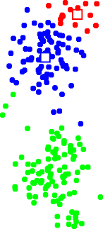
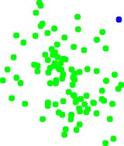

Iteration 3

Slide 13
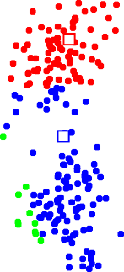

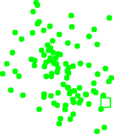

Iteration 10

Slide 14
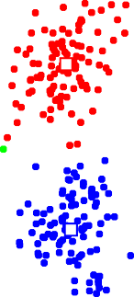

Final clustering

Slide 15
Convergence
1.5
_{J}clust
1
0.5
1 3 5 7 9 11 13 15
Iteration

Slide 16
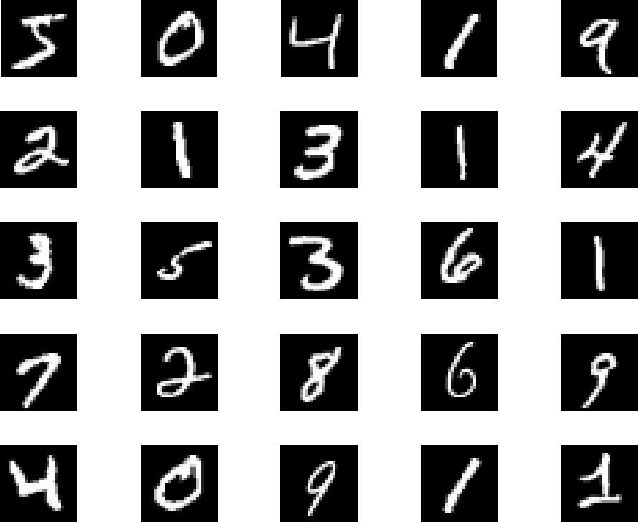
Handwritten digit image set
^{e} MNIST images of handwritten digits (via Yann Lecun)
^{e} N = 60, 000 28 × 28 images, represented as 784-vectors x_{i}
^{e} 25 examples shown below

Slide 17
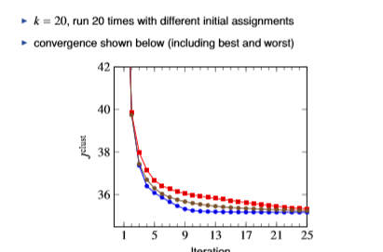
k-means image clustering

Slide 18
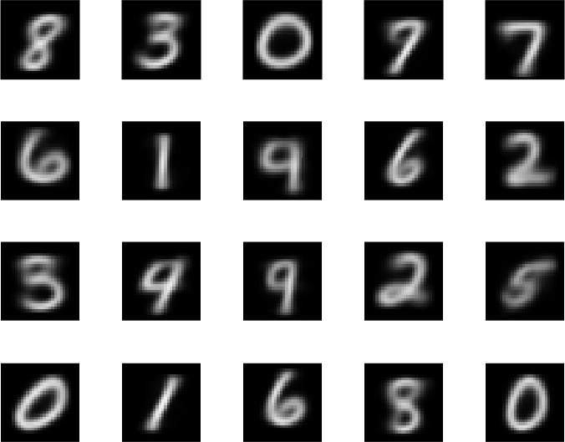
Group representatives, best clustering

Slide 19
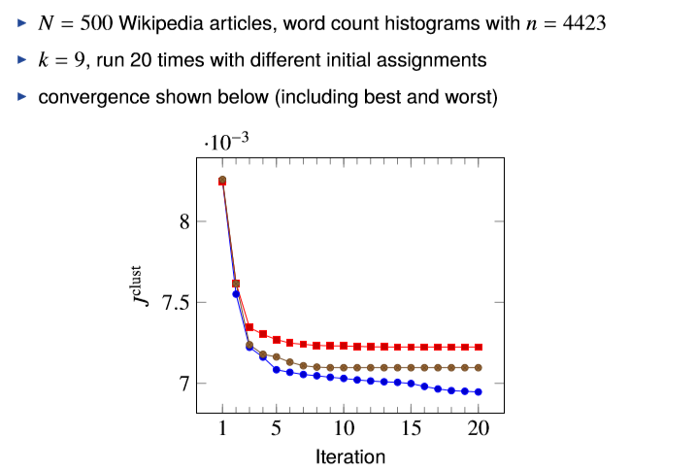
Topic discovery

Slide 20
Topics discovered (clusters 1–3)
^{e} words with largest representative coefficients
Cluster 1 | Cluster 2 | Cluster 3
Word Coef. | Word Coef. | Word | Coef.
fight 0.038 | holiday 0.012 | united | 0.004
win 0.022 | celebrate 0.009 | family | 0.003
event 0.019 | festival 0.007 | party | 0.003
champion 0.015 | celebration 0.007 | president | 0.003
fighter 0.015 | calendar 0.006 | government | 0.003
^{e} titles of articles closest to cluster representative
1.“Floyd Mayweather, Jr”, “Kimbo Slice”, “Ronda Rousey”, “José Aldo”, “Joe Frazier”, “Wladimir Klitschko”, “Saul Álvarez”, “Gennady Golovkin”, “Nate Diaz”, . . .
2.“Halloween”, “Guy Fawkes Night” “Diwali”, “Hanukkah”, “Groundhog Day”, “Rosh Hashanah”, “Yom Kippur”, “Seventh-day Adventist Church”, “Remembrance Day”, . . .
3.“Mahatma Gandhi”, “Sigmund Freud”, “Carly Fiorina”, “Frederick Douglass”, “Marco Rubio”, “Christopher Columbus”, “Fidel Castro”, “Jim Webb”, . . .

Slide 21
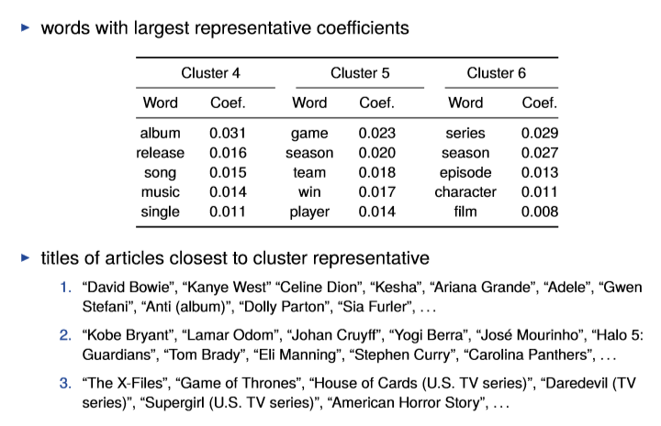
Topics discovered (clusters 4–6)

Slide 22
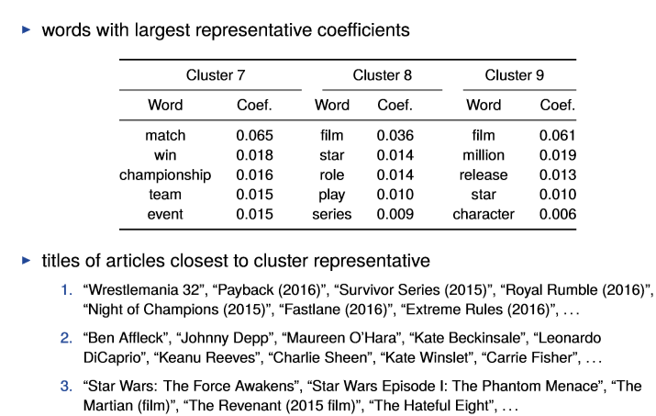
Topics discovered (clusters 7–9)

